Slide 1
SmartFit Losing Weight The Smart Way
Student Number: 170412751
Student Name: Muhammed Ismael Ali
Supervisor Name: Thomas Roelleke

Slide 2
Project Aims
Create a simple user-friendly diet & fitness application on Android OS (Simplicity is key)
Focus on tracking calories lost throughout the day (As current applications focus on tracking calories consumed)
Provide users with key information they need such as how many calories should they burn, how many calories should they consume etc.…
Introduce a system to keep diet & fitness app users motivated through implementation of gamification elements (In the form of rewards i.e. Badges)
Promote a sense of competition within the app by allowing users to view other users (Friends) progress & recorded activities so they can compete and try do better.

Slide 3
Project Objectives
Produce an effective user-friendly design of the application that incorporates simplicity whilst also maintaining a aesthetically pleasing look.
Develop the diet & fitness applications with the main intended features (Tracking calories lost, providing automatic health tracking, Recording progress & viewing activities recorded by other users to promote a sense of competition).
Perform user-testing once the application has been developed to conclude effectiveness
Evaluate the application (What could I have changed, what could I have done differently).

Slide 4
Literature Review Findings
Gamification has been used as a popular strategy to influence behavior of consumers.
Use of rewards, challenges, goal setting, competitiveness have all been used to keep users motivated.
NextJump carried out campaign and saw the effectiveness of using gamification to increase the fitness levels of its employees, it was a positive result.
A lot of current applications have a cluttered UI which makes using them quite tricky. A lot of these applications only provide calorie consumption tracking and also provide a not so visually pleasing UI from what I’ve examined.
Existing applications have automatic health tracking using external devices or built in device functionalities like accelerometer (Which I plan to implement to make it easier for users to record progress).

Slide 5
How Will You Evaluate Your Solution?
I will carry out a Heuristic Evaluation of my application as the main goal of my project is to provide an application that is easy to use and navigate without posing much issue or annoyance to the users.
I will also evaluate the effects of the intended gamifications features that are to be implemented to answer some of the questions that have piqued my interest during my research such as “How much gamification should be implemented before users no longer care?”. “Is gamification effective enough to keep users interested in the long-term or is it a short-term satisfaction”.
I will also evaluate the effectiveness of my application as a whole on the functionalities that the application will provide.

Slide 6
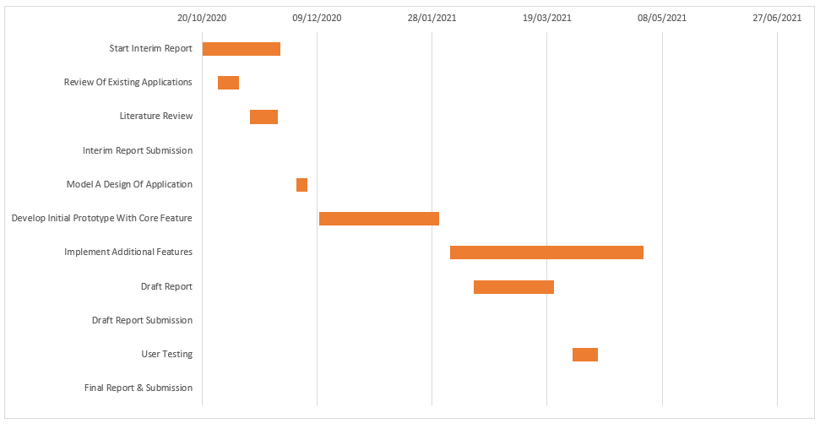
Project Planning

Slide 7
Risk Register
Description Of Risk | Description Of Impact | Likelihood Rating | Impact Rating | Preventative Actions
Corruption Of Work/Work Being Deleted Or Lost | Nothing to submit resulting in a fail | Low | High | Always create a backup copy of the project work. For the documented report, services such as google drive can be used to upload and keep my work safe and secure or the use of external storage drive such as a USB can be used. For the program services such as GitHub can be used to ensure the program is stored securely even if something was to happen to my computer.
Falling Ill/Health Issues | This will result in less work being completed as well as throw off the project time plan. Also, if the illness occurs near deadlines it will lead to delayed submissions | Medium | High | Ensure I am on top of the project work and sticking closely or ahead of the project time plan to handle unforeseen events such as falling ill. In addition to this, maintaining my health should be a top tier priority especially since we are experiencing a pandemic.
Neglecting Project Work Due To Assignments From Other Modules | This will lead to an inability and struggle to meet deadlines as the project work will be piled up | Low | High | Create a timetable to divide the work load, making sure I am not behind on any lectures for other modules as this will consume/cut into project working hours.
Incorrect Implementation Of Features | If a feature is not implemented correctly it will need to be revised which will cut into hours that can be used elsewhere | Medium | Medium | Research on the implementation methods for the different features thoroughly before attempting to program them.

Slide 8
References
Oliver Vicente, Sandra Vicente, Daniel Martin, Miguel Angel Rodriguez-Florido, and Manuel Maynar. 2014. Health gamification. In Proceedings of the 2014 Summer Simulation Multiconference (SummerSim '14). Society for Computer Simulation International, San Diego, CA, USA, Article 57, 1–7.
Kappen, D. and Orji, R., 2017. Gamified and persuasive systems as behaviour change agents for health and wellness. XRDS: Crossroads, The ACM Magazine for Students, 24(1), pp.52-55.
Lister, C., West, J., Cannon, B., Sax, T. and Brodegard, D., 2014. Just a Fad? Gamification in Health and Fitness Apps. JMIR Serious Games, 2(2), p.e9.

